Slide 1
MIS
CHAPTER 2
COMPUTERS: THE MACHINES BEHIND COMPUTING
Hossein BIDGOLI

Slide 2
Chapter 2 Computers: The Machines Behind Computing
l e a r n i n g o u t c o m e s
LO1 Define a computer system and describe its components.
LO2 Discuss the history of computer hardware and software.
LO3 Explain the factors distinguishing computing power of computers.
LO4 Describe the major operations of computers
LO5 Summarize the binary system and data representation.

Slide 3
Chapter 2 Computers: The Machines Behind Computing
l e a r n i n g o u t c o m e s (cont’d.)
LO6 Discuss the types of input, output, and memory devices.
LO7 Explain how computers are classified.
LO8 Describe the two major types of software.
LO9 List the generations of computer languages.

Slide 4
Defining a Computer
Computer
  Machine that accepts data as input
  Processes data without human intervention using stored instructions
  Outputs information
“Program”
  Step-by-step directions for performing a specific task
  Written in a language the computer can understand
GIGO
  Garbage in, garbage out

Slide 5
Components of a Computer System
Hardware components
  Physical devices, such as keyboards, monitors, and processing units
Software
  Programs written in computer languages
Central processing unit (CPU)
  Arithmetic logic unit (ALU)
  Control unit
  Single or multiprocessor

Slide 6
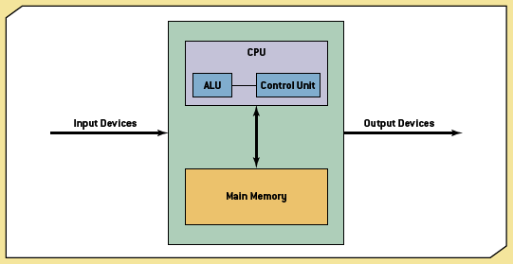
Exhibit 2.1
The Building Blocks of a Computer

Slide 7
Components of a Computer System (cont'd.)
Bus
  Link between devices connected to the computer
Computer performance factors
  Processor
  Bus
  Operating system
Disk drive
CPU case
Motherboard
  Main circuit board

Slide 8
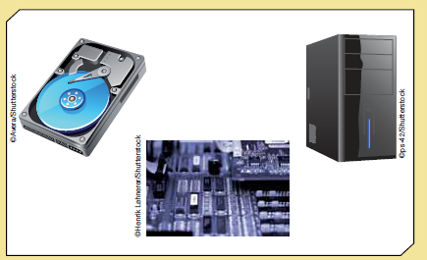
Exhibit 2.2
Components of a Computer System

Slide 9
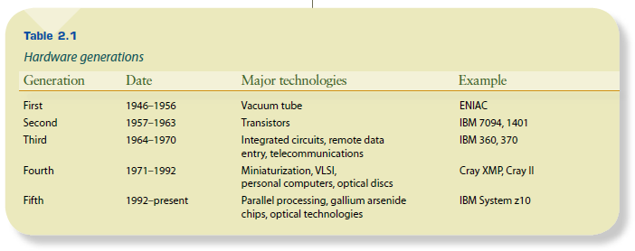
Table 2.1
Hardware Generators
The History of Computer Hardware and Software

Slide 10
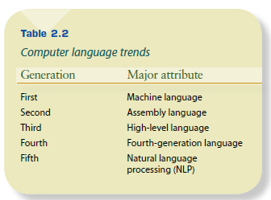
The History of Computer Hardware and Software (cont’d.)
Table 2.2
Computer Language Trends

Slide 11
The Power of Computers
Factors that exceed human capacities:
  Speed
  Accuracy
  Storage and retrieval

Slide 12
Speed
Computer speed measured as the number of instructions performed per fractions of a second:
  Millisecond: 1/1000 of a second
  Microsecond: 1/1,000,000 of a second
  Nanosecond: 1/1,000,000,000 of a second
  Picosecond: 1/1,000,000,000,000 of a second

Slide 13
Accuracy
Computers don’t make mistakes
Degree of accuracy is critical in many computer applications
Example
  Space mission calculations

Slide 14
Storage and Retrieval
Storage: saving data in computer memory
Retrieval: accessing data from memory
Data is stored in bits
  Eight bits is one byte
  Binary system
American Standard Code for Information Interchange (ASCII)
  Data code to represent and transfer data between computers and network systems
  Up to 128 characters can be defined

Slide 15
Computer Operations
Three basic tasks:
  Arithmetic operations
    Add, subtract, multiply, divide, raise to power
  Logical operations
    Comparison
  Storage and retrieval operations

Slide 16
Spotlight on Computer Storage
Millipede
Developed by IBM
Allows storing one trillion bits of data per square inch
Could buy a storage device of 1 TB for less than $400
Uses thousands of very fine silicon tips to punch holes into a thin film of plastic

Slide 17
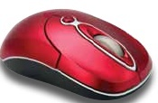
Input Devices
Input devices
  Send data and information to computer
Types
  Keyboard
  Mouse
  Touch screen
  Light pen
  Trackball
  Data tablet
  Barcode reader
  Optical character reader
  Magnetic ink character recognition system
  Optical mark recognition system

Slide 18
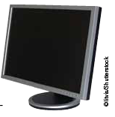
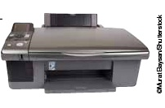
Output Devices
Output devices
  For mainframes and personal computers
Soft copy
  Monitor
    Cathode ray tube (CPT), plasma, liquid crystal display (LCD)
Hard copy
  Printer
    Inkjet, laser
  Voice

Slide 19
Memory Devices
Main memory
  Stores data and information
  Volatile
Secondary memory
  Nonvolatile
  Holds data when the computer is off or during course of a program's operation
  Serves as archival storage

Slide 20
Main Memory Devices
Semiconductor chips made of silicon
Random access memory (RAM)
  Volatile
  Cache RAM
Read only memory (ROM)
  Nonvolatile
  BIOS and system clock
  PROM
  EPROM

Slide 21
Secondary Memory Devices
Magnetic disks
  Made of mylar or metal
  Used for random-access processing
Magnetic tape
  Made of a plastic material
  Stores data sequentially
Optical discs
  Use laser beams to access and store data
  CD-ROM, WORM, DVD

Slide 22
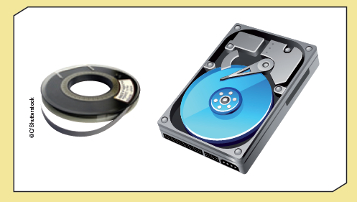
Exhibit 2.3
Magnetic Memory Devices

Slide 23
Secondary Memory Devices (cont'd.)
Other secondary memory
  Hard disk
  USB flash drive
  Memory card
Redundant array of independent disks (RAID) system
  Collection of disk drives used for fault tolerance and improved performance
  If one disk in the array fails, data isn’t lost

Slide 24
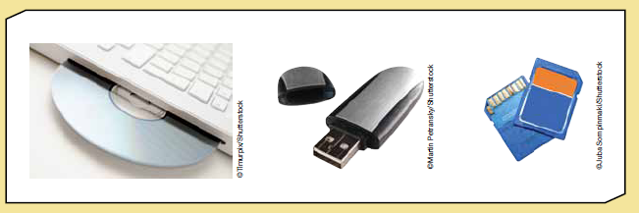
Exhibit 2.4
Examples of Memory Devices

Slide 25
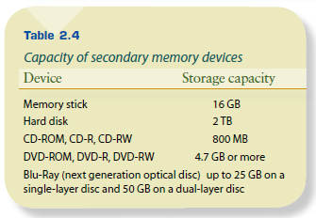
Table 2.4
Capacity of Secondary Memory Devices

Slide 26
Storage Area Networks and Network-Attached Storage
Storage area network (SAN)
  Dedicated high-speed network consisting of both hardware and software
  Connect and manage shared storage devices
  Makes storage devices available to all servers on a network
Network-attached storage (NAS)
  Network-connected computer dedicated to providing file-based data storage services to other network devices

Slide 27
Classes of Computers
Classify based on:
  Cost, amount of memory, speed, sophistication
Types
  Subnotebooks, notebooks, personal, minicomputers, mainframes, supercomputers

Slide 28
Popular iPad Business Applications
Healthcare workers
Sales agents and service workers
Insurance agents
Real estate agents
Legal professionals
Teachers and students
Financial professionals
Corporate campus workers
Remote and mobile workers

Slide 29
Ubiquitous Computing
Also called:
  Pervasive computing
  Third wave computing
Wearable computers
  Cell phones
  Medical devices

Slide 30
Server Platforms: An Overview
Server
  Computer and all the software for managing network resources and offering services to a network
Types of servers
  Application
  Database
  Disk
  Fax
  File
  Mail
  Print
  Remote access (RAS)
  Web

Slide 31
What is Software?
All the programs that run a computer system
Classified broadly as:
  System software
  Application software

Slide 32
Operating System Software
Operating system (OS)
  Set of programs for controlling and managing computer hardware and software
  Provides an interface between a computer and the user
  Increases computer efficiency by helping users share computer resources and performing repetitive tasks for users

Slide 33
Operating System Software (cont'd.)
Operating system control programs
  Job management
  Resource allocation
  Data management
  Communication
Kernel
  Supervisor program
  Responsible for controlling all other programs in the OS

Slide 34
Google Docs: Applications and Challenges
Free Web-based application for creating:
  Word processor documents, spreadsheets, presentations, and forms
Create and edit document
Collaboration in real time
Save in various formats
Cloud computing
  Security risks

Slide 35
Application Software
Application software
  Commercial software or software developed in-house
Software types
  Word processing
  Spreadsheet
  Database
  Presentation
  Graphics
  Desktop publishing

Slide 36
Application Software (cont'd.)
  Financial planning and accounting
  Project management
  Computer-aided design (CAD)

Slide 37
Computer Languages
Machine language
  0s and 1s
  Code written for one type of computer does not work on another
Assembly language
  Higher level than machine but still machine dependent

Slide 38
Computer Languages (cont'd.)
High-level languages
  C++, Java, VB.Net
  Used for Web development and the Internet
Fourth-generation languages
  Easiest to use
  SQL

Slide 39
Computer Languages (cont'd.)
Fifth-generation languages (5GLs)
  Knowledge-based systems
  Natural language processing (NLP)
  Visual programming
  Graphical approach to using programming

Slide 40
Summary
Components and distinguishing factors of computers
Brief history of computer hardware and software
Input, output, and memory devices
Classifications for computers
Different types of software
Generations of computer languages

